Slide 1
Annual Performance Review Data Summary
Produced for South Ward Promise Neighborhood
By Caroline Taggart & Shontay Barnes, Via Evaluation
Summer 2023

Slide 2
table of contents
introduction
community survey data
01
04
student academic performance and demographic gpras
additional data
02
05
student survey perception and participation data and gpras
key findings & conclusions
03
06
intro
academics
student survey
community survey
additional data
conclusions

Slide 3
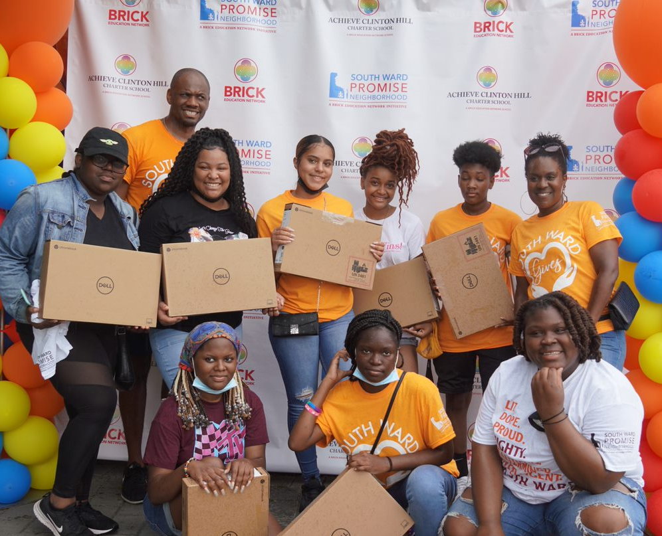
introduction
overview of south ward promise neighborhood’s data and evaluation process

Slide 4
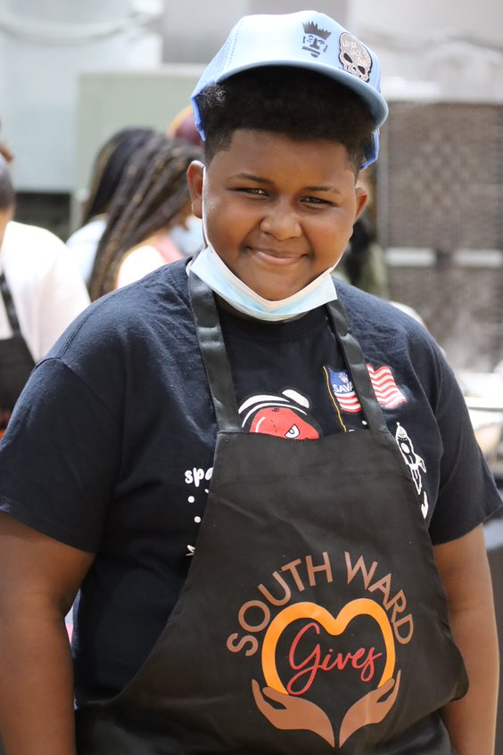
introduction
why are we talking about this?
How are these performance measures and data points important and meaningful?
The South Ward Promise Neighborhood is funded by a US Department of Education Promise Neighborhoods grant. These grants require that funded organizations report on 10 established Government Performance and Results Act indicators, known as GPRAs. Grantees must also conduct a school climate and culture survey of 6th through 12th grade students attending partner schools every year, and a community survey of people residing in their Promise Neighborhood every other year.
This presentation shares these data with the community.
While the required data are intended to provide a comprehensive assessment of progress and impact of the Promise Neighborhood’s work, there are additional data that may be more meaningful to the community in understanding how well the Promise Neighborhood is operating.
intro
academics
student survey
community survey
additional data
conclusions

Slide 5
introduction
what is the South Ward Promise Neighborhood?
The South Ward Promise Neighborhood is a powerful collaborative effort of more than 25 organizations working together to invest in South Ward families. The South Ward Promise Neighborhood launched in 2018 with a U.S. Department of Education Promise Neighborhood grant. Partners offer free programs and services to ensure children receive support at every stage of development from prenatal to college and career. Our goal is to ensure every child growing up in the South Ward Promise Neighborhood will have access to high-quality early childhood centers, schools, healthcare, and housing. The South Ward Promise Neighborhood offers a system of family and community support services to ‘knock down walls and build up kids’ changing the course of generations to come, beginning with you!
intro
academics
student survey
community survey
additional data
conclusions

Slide 6
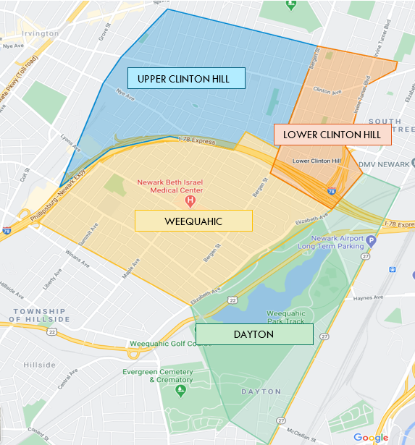
introduction
where is the South Ward Promise Neighborhood?
The South Ward Promise Neighborhood includes the 4 neighborhoods within the South Ward. The prior round of grant funding focused on Upper Clinton Hill and Dayton, while the current round of funding focused on Lower Clinton Hill and Weequahic.
The zip codes 07108 and 07112 are the primary zip codes within the currently-funded South Ward Promise Neighborhood.
intro
academics
student survey
community survey
additional data
conclusions

Slide 7
introduction
when are we collecting data?
GPRA 9 (reading)
perceptions
needs & assets
GPRA 9 (reading)
perceptions
needs & assets
Community Survey
Community Survey
2021-22
2022-23
2023-24
2024-25
2025-26
2026-27
baseline
Sept
Oct
Nov
Dec
Jan
Feb
Mar
Apr
May
June
July
Aug
K Readiness Assessment
Student Survey
NJSLAs
End-of Year data
GPRA 1
GPRA 6 (healthy eating)
GPRA 7 (safety)
GPRA 10 (internet access)
climate & culture
GPRA 2
GPRA 3 (attendance)
GPRA 4 & 5 (grad & post-grad)
GPRA 8 (student mobility)
intro
academics
student survey
community survey
additional data
conclusions
Notes:
A community survey is required to be conducted every two years. The first survey was conducted in December 2022-January 2023. The next will be conducted in January 2025, followed by January 2027.
Each year, a school-based student survey is required to be conducted. These will be administered by partner schools during the late winter/early spring of each school year.
In the fall of each new school year, all kindergartners at participating partner schools will be assessed for general Kindergarten readiness using a valid, nationally-normed student assessment tool, such as NWEA MAP or the GOLD assessment.
In the late spring of each academic year, all 3rd – 8th grade students and some high school students take the NJSLA ELA and Math assessments.
At the end of each academic year, all partner school data related to student attendance, student mobility, and student graduation is analyzed.

Slide 8
introduction
when are we reporting on data?
CAN Meetings
CAN Meetings
All-Partner Meeting
All-Partner Meeting
APR
Ad-Hoc APR
Jan
Feb
Mar
Apr
May
Jun
July
Aug
Sept
Oct
Nov
Dec
YEAR 1
2022
YEAR 2
2023
YEAR 3
2024
YEAR 4
2025
YEAR 5
2026
intro
academics
student survey
community survey
additional data
conclusions
Notes:
All funded Promise Neighborhoods are required to report on 10 GPRA (Government Performance and Results Act) indicators, established by the Department of Education. South Ward Promise Neighborhood submits their Annual Performance Report, inclusive of progress towards all 10 GPRAs and budget information, on March 31 of each project year. An Ad-Hoc report is due July 31 of each year to secure the following year of funding.
SWPN hosts all-partner meetings at least 2x a year, sharing data with the community and partners.
SWPN holds quarterly Community Action Network (CAN) meetings, during which time data are also shared.

Slide 9
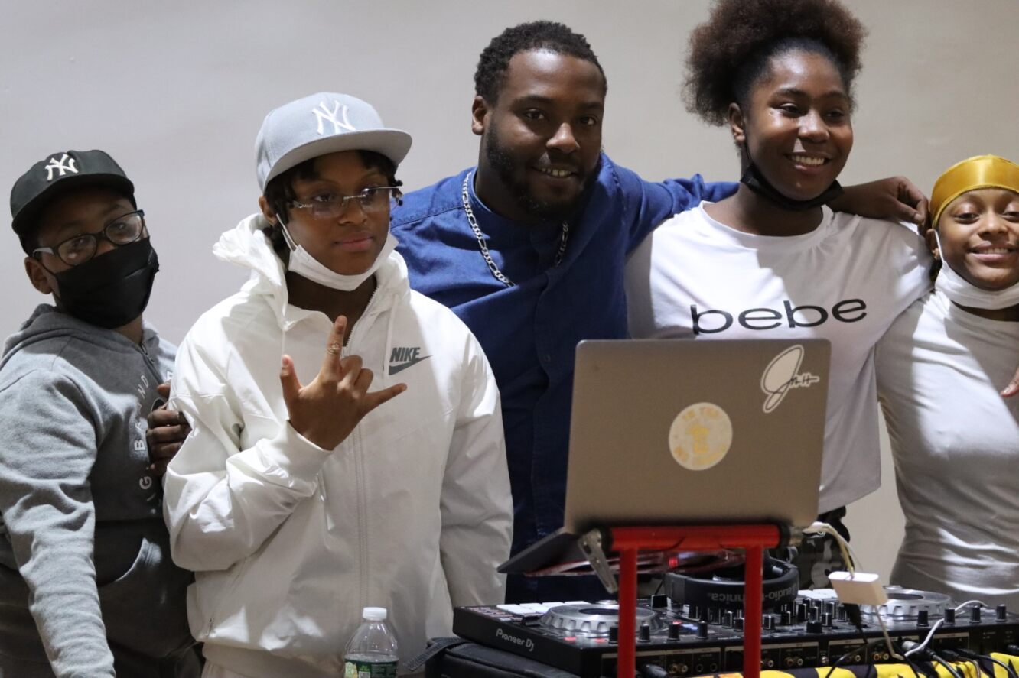
student academic indicators
student academic performance and demographic gpras

Slide 10
student academic indicators
GPRA 1
kindergarten readiness • number and percent of kindergartners who demonstrate age-appropriate functioning across multiple domains
Students are classified as ready by meeting K performance standards on numeracy and literacy tools, as set by the tool (NWEA MAP).
K Ready in Fall 2022
ACCS (7%)
Great Oaks (37%)
32%
There is no baseline data presented for this GPRA because of a change in student population and how the tool was being administered.
intro
academics
student survey
community survey
additional data
conclusions
Notes:
GPRA 1 K Readiness
CURRENT DATA:
Year 1 (Fall 2022) Total = 32.1% (89/277 tested) students performing at or above expected K entry proficiency on NWEA MAP
ACCS = 7% (3/43 tested)
Great Oaks = 37% (86/234 tested)
PRIOR DATA:
Baseline (Fall 2021) → ACCS = 43/59 = 73% (reported in Scorecard, but not here because something is off about how data were collected, and this should not be presented as a baseline).
DATA SOURCES and NOTES:
Data from these measures are provided by the schools. The data include student-level results on the NWEA MAP assessments conducted in the Fall (i.e., beginning of the academic year) and indicate whether the student was performing at or above grade level (i.e., at or above expected beginning of the kindergarten year level) or below grade level on a reading/literacy assessment and a math/numeracy assessment. Students who are performing at or above grade level on both portions of the assessment are categorized as “kindergarten ready” for the purposes of this GPRA.

Slide 11
student academic indicators
GPRA 2.1
math performance • number and percent of 3rd – 8th and HS students at or above grade level according to state mathematics assessments
Students are considered proficient if they score a level 4 or level 5 on the NJSLA in Mathematics.
32%
Proficient in Math Spring 2023
ACCS = 19% (51/274)
Great Oaks = 20% (242/1185)
KIPP = 20% (658/3258)
North Star = 47% (1717/3652)
19%
Proficient in Math Spring 2022
ACCS = 21% (58/276)
Great Oaks = 20% (244/1213)
KIPP = 15% (269/1825)
North Star = 40% (137/345)
intro
academics
student survey
community survey
additional data
conclusions
Notes:
GPRA 2.1 Student Math Performance
CURRENT DATA:
Year 1 (Spring 2023)= 31.9% (2668/8375)
ACCS = 19% (51/274)
Great Oaks = 20% (242/1185)
KIPP = 20% (658/3258)
North Star = 47% (1717/3652)
PRIOR DATA:
Baseline (Spring 2022) = 19.3% (708/3659)
ACCS = 21% (58/276)
Great Oaks = 20% (244/1213)
KIPP = 15% (269/1825)
North Star = 40% (137/345)
DATA SOURCES and NOTES:
Data from these measures are provided by the schools. The data include student-level results on the NJSLA Math assessment conducted in the Spring of each academic year. Per NJSLA standards, students who score a 4 or a 5 (out of 5) are categorized as “at or above grade level”.

Slide 12
at or above performance in Math by grade
student academic indicators
intro
academics
student survey
community survey
additional data
conclusions
Notes:
GPRA 2.1 Student Math Performance, by grade level
CURRENT DATA:
Year 1 (Spring 2023)= 31.9% (2668/8375
3rd grade = 41.7% (545/1307)
4th grade = 40.9% (507/1240)
5th grade = 28.7% (381/1329)
6th grade = 23.6% (314/1329)
7th grade = 32.4% (378/1168)
8th grade = 31.0% (365/1176)
High School = 21.5% (178/826)
PRIOR DATA:
Baseline (Spring 2022) = 19.3% (708/3659)
3rd grade = 21.2% (123/524)
4th grade = 18.0% (106/531)
5th grade = 19.5% (100/491)
6th grade = 17.2% (85/502)
7th grade = 27.4% (157/548)
8th grade = 24.5% (114/521)
High School = 2.0% (23/542)

Slide 13
student academic indicators
GPRA 2.2
ela performance • number and percent of 3rd – 8th and HS students at or above grade level according to ela assessments
Students are considered proficient if they score a level 4 or level 5 on the NJSLA in ELA.
Proficient in ELA Spring 2023
51%
ACCS = 40% (111/278)
Great Oaks = 40% (477/1187)
KIPP = 39% (1277/3280)
North Star = 66% (2411/3669)
Proficient in ELA Spring 2022
38%
ACCS = 40% (111/276)
Great Oaks = 39% (421/1068)
KIPP = 31% (580/1842)
North Star = 65% (224/347)
intro
academics
student survey
community survey
additional data
conclusions
Notes:
GPRA 2.2 Student ELA Performance
CURRENT DATA:
Year 1 (Spring 2023)= 50.8% (4276/8414)
ACCS = 40% (111/278)
Great Oaks = 40% (477/1187)
KIPP = 39% (1277/3280)
North Star = 66% (2411/3669)
PRIOR DATA:
Baseline (Spring 2022) = 37.8% (1336/3533)
ACCS = 40% (111/276)
Great Oaks = 39% (421/1068)
KIPP = 31% (580/1842)
North Star = 65% (224/347)
DATA SOURCES and NOTES:
Data from these measures are provided by the schools. The data include student-level results on the NJSLA ELA assessment conducted in the Spring of each academic year. Per NJSLA standards, students who score a 4 or a 5 (out of 5) are categorized as “at or above grade level”.

Slide 14
student academic indicators
at or above performance in ELA by grade
intro
academics
student survey
community survey
additional data
conclusions
Notes:
GPRA 2.2 ELA Performance, by grade level
CURRENT DATA
Year 1 (Spring 2023) = 50.8% (4276/8414)
3rd grade = 40% (521/1305)
4th grade = 52% (652/1248)
5th grade = 46% (618/1334)
6th grade = 47% (629/1341)
7th grade = 61% (720/1174)
8th grade = 63% (744/1186)
High School = 47% (392/826)
PRIOR DATA
Baseline (Spring 2022) = 37.8% (1336/3533)
3rd grade = 23.5% (135/528)
4th grade = 32.8% (172/530)
5th grade = 37.4% (183/493)
6th grade = 39.5% (208/507)
7th grade = 46.0% (272/546)
8th grade = 55.0% (263/526)
High School = 25.6% (103/403)

Slide 15
at or above performance by grade and subject
student academic indicators
3rd
4th
5th
6th
7th
8th
HS
3rd
4th
5th
6th
7th
8th
HS
intro
academics
student survey
community survey
additional data
conclusions

Slide 16
student academic indicators
GPRA 3.1
attendance rate • average daily attendance for 6th – 9th grade students
Average Daily Attendance 2022-23
89%
6th grade = 90%
7th grade = 89%
8th grade = 90%
9th grade = 87%
ACCS = 93%
Great Oaks = 91%
KIPP = 88%
North Star = 91%
ADA is calculated by dividing the sum of each student’s days of attendance by the sum of each student’s total days of enrollment.
Average Daily Attendance 2021-22
79%
6th grade = 76%
7th grade = 76%
8th grade = 78%
9th grade = 87%
ACCS = 94%
Great Oaks = 61%
KIPP = 86%
North Star = 89%
intro
academics
student survey
community survey
additional data
conclusions
Notes:
GPRA 3.1 Average Daily Attendance of 6th – 9th grade students
CURRENT DATA:
Year 1 (2022-2023 academic year) = 89.1% (501,779 days in attendance/563,420 total days enrolled)
6th grade = 90% (151,339/168,225)
7th grade = 89% (123,019/138,378)
8th grade = 90% (127,137/141,335)
9th grade = 87% (100,284/115,482)
ACCS 6-9 = 93% (17,850/19,243)
Great Oaks 6-9 = 91% (117,304/129,535)
KIPPs 6-9 = 88% (288,836/329,230)
North Star 6-9 = 91% (77,789/85,412)
PRIOR DATA:
Baseline (2021-2022 academic year) = 79.0% (319,288 days in attendance/404,376 total days enrolled)
6th grade = 76% (74,711/98,173)
7th grade = 76% (84,041/110,236)
8th grade = 78% (91,716/116,585)
9th grade = 87% (68,820/79,382)
ACCS 6-9 = 94% (17677/18807)
Great Oaks 6-9 = 61% (78126/127517)
KIPPs 6-9 = 86% (162980/190030)
North Star 6-9 = 89% (60505/68022)
DATA SOURCES and NOTES:
Data from these measures are from the SID files provided by the schools. These files contain student-level data, including the number of days each student was in attendance at school and the total number of days that the student was enrolled in the school. To determine ADA per the PN program’s instructions, the total number of days students were present are added up and divided by the total number of days those students were enrolled.

Slide 17
average daily attendance by grade
student academic indicators
intro
academics
student survey
community survey
additional data
conclusions
Notes:
Average Daily Attendance for All Grades in PN Partner Schools
CURRENT DATA:
Year 1 (2022-2023) = 88% (1,522,145 days in attendance/1,726,701 total days enrolled)
K = 87%
1st = 88%
2nd = 88%
3rd = 89%
4th = 89%
5th = 90%
6th grade = 90% (151,339/168,225)
7th grade = 89% (123,019/138,378)
8th grade = 90% (127,137/141,335)
9th grade = 87% (100,284/115,482)
10th = 85%
11th = 85%
12th = 84%
PRIOR DATA:
Baseline (2021-2022) = 83% (989,530 days in attendance/1,185,887 total days enrolled)
K = 88%
1st = 87%
2nd = 87%
3rd = 88%
4th = 88%
5th = 81%
6th grade = 76% (74,711/98,173)
7th grade = 76% (84,041/110,236)
8th grade = 78% (91,716/116,585)
9th grade = 87% (68,820/79,382)
10th = 85%
11th = 84%
12th = 79%
DATA SOURCES and NOTES:
Data from these measures are from the SID files provided by the schools. These files contain student-level data, including the number of days each student was in attendance at school and the total number of days that the student was enrolled in the school. To determine ADA per the PN program’s instructions, the total number of days students were present are added up and divided by the total number of days those students were enrolled.

Slide 18
student academic indicators
GPRA 3.2
chronic absenteeism • percent of 6th – 9th grade students who missed 10% or more of enrolled school days
Chronically Absent in 2022-23
35%
6th grade = 36%
7th grade = 37%
8th grade = 30%
9th grade = 40%
ACCS = 21%
Great Oaks = 21%
KIPP = 45%
North Star = 24%
Students who missed 10% of enrolled days are considered chronically absent.
46%
Chronically Absent in 2021-22
6th grade = 49%
7th grade = 48%
8th grade = 38%
9th grade = 51%
ACCS = 13%
Great Oaks = 52%
KIPP = 53%
North Star = 23%
intro
academics
student survey
community survey
additional data
conclusions
Notes:
GPRA 3.2 Chronic Absenteeism among 6th – 9th grade students
CURRENT DATA:
Year 1 (2022-23) = 35.4% (1153/3253)
6th grade = 36% (347/976)
7th grade = 37% (295/800)
8th grade = 30% (242/805)
9th grade = 40% (269/672)
ACCS = 21% (25/118)
Great Oaks = 21% (150/730)
KIPP = 45% (865/1926)
North Star = 24% (113/479)
PRIOR DATA:
Baseline (2021-22) = 46.1% (1053/2286)
6th grade = 49.3% (274/556)
7th grade = 47.6% (295/620)
8th grade = 38.2% (248/650)
9th grade = 51.3% (236/460)
ACCS = 13% (14/107)
Great Oaks = 52% (377/721)
KIPP = 53% (580/1093)
North Star = 23% (88/377)
DATA SOURCES and NOTES:
Data from these measures are from the SID files provided by the schools. These files contain student-level data, including the number of days each student was in attendance at school and the total number of days that the student was enrolled in the school. To determine whether a student was chronically absent or not, the total number of days in attendance is subtracted from the total number of days of enrollment to get the number of days absent. This is divided by the number of days enrolled to determine the percent of days the student was absent. Students who were absent 10.00% or more of days are classified as “chronically absent” for the purposes of this GPRA.

Slide 19
chronic absenteeism by grade
student academic indicators
intro
academics
student survey
community survey
additional data
conclusions
Notes:
Chronic Absenteeism for All Grades in PN Partner Schools
CURRENT DATA:
Year 1 (2022-2023) = 41% (4108 chronically absent of 9989 with attendance data)
K = 43%
1st = 45%
2nd = 45%
3rd = 41%
4th = 42%
5th = 31%
6th grade = 36% (347/976)
7th grade = 37% (295/800)
8th grade = 30% (242/805)
9th grade = 40% (269/672)
10th = 49%
11th = 46%
12th = 65%
PRIOR DATA:
Baseline (2021-2022) = 50% (3389 chronically absent of 6835 with attendance data)
K = 47%
1st = 51%
2nd = 51%
3rd = 46%
4th = 45%
5th = 44%
6th grade = 49.3% (274/556)
7th grade = 47.6% (295/620)
8th grade = 38.2% (248/650)
9th grade = 51.3% (236/460)
10th = 54%
11th = 59%
12th = 77%
DATA SOURCES and NOTES:
Data from these measures are from the SID files provided by the schools. These files contain student-level data, including the number of days each student was in attendance at school and the total number of days that the student was enrolled in the school. To determine ADA per the PN program’s instructions, the total number of days students were present are added up and divided by the total number of days those students were enrolled.

Slide 20
student academic indicators
GPRA 4
high school graduation • percent of students graduating in four years
This is a 4-year cohort graduation rate, measuring the percent of students who earn a HS diploma within 4 years of starting 9th grade.
94%
Class of 2023 Graduated
Great Oaks = 97%
North Star = 92%
KIPP = N/A at time of report
Class of 2022 Graduated
96%
Great Oaks = 95%
KIPP = 96%
intro
academics
student survey
community survey
additional data
conclusions
Notes:
GPRA 4 Graduation Rate
CURRENT DATA:
Year 1 (2022-23) = 93.8% (227/242)
Great Oaks = 96.6% (84/87)
North Star = 92.3% (143/155)
KIPP Newark Collegiate = N/A at time of reporting
PRIOR DATA:
Baseline (2021-22) = 95.5% (276/289)
Great Oaks = 95.4% (83/87)
KIPP Newark Collegiate = 95.5% (193/202)
DATA SOURCES and NOTES:
Schools with a 12th grade provide the number of students who graduated within 4 years, and the number of students who were included in the 4 year cohort. The number of students who graduated is divided by the number in the cohort to determine the graduation rate for this GPRA.
At time of August 2023 report, KIPP Newark Collegiate data were not yet available.

Slide 21
student academic indicators
GPRA 5.1
post-secondary enrollment • percent of PN students who enroll in a 2-yr or 4-yr college or university within 16 months of HS graduation
89%
Class of 2023 Enrolled in Post-Secondary
2-Year = 2%
4-Year = 88%
Class of 2022 Enrolled in Post-Secondary
93%
2-Year = 7%
4-Year = 86%
intro
academics
student survey
community survey
additional data
conclusions
Notes:
GPRA 5.1 Post-Secondary Enrollment
CURRENT DATA:
Year 1 (2022-23): 89% (136/152)
School Totals →
North Star = 89% (136/152)
5.1.a. 2-year enrollment
North Star = 3
5.1b. 4-year enrollment
North Star = 133
PRIOR DATA:
Baseline (2021-22) [not reported until Aug 2023]: 93% (126/135)
School Totals →
North Star = 93% (126/135)
5.1.a. 2-year enrollment
North Star = 10
5.1b. 4-year enrollment
North Star = 116
DATA SOURCES and NOTES:
Schools with a 12th grade provide the number of students who graduated within a class year, and the number of students who are enrolled or intend to enroll in 2-year and 4-year institutions. The number of students who enrolled is divided by the number of graduates within the class year for this GPRA.
At time of August 2023 report, KIPP Newark Collegiate and Great Oaks Legacy data were not yet available.

Slide 22
student academic indicators
GPRA 5.2
post-secondary completion • percent of PN students who graduate from a 2-yr, 4-yr, or vocational certificate program
We don’t have data on this at this time. We are still working to define who counts as a “PN student” and how to find out whether they have completed these programs within the timeframe requested by the Department of Education.
intro
academics
student survey
community survey
additional data
conclusions
Notes:
GPRA 5.2 Post-Secondary Completion
CURRENT DATA: at the time of this report, no data were available to answer this GPRA.

Slide 23
student academic indicators
GPRA 8
student mobility • percent of students switching schools within the school year
This is calculated by dividing the number of students who enter and exit participating schools during the school year by the total number enrolled across the whole year.
Student Mobility Rate 2022-23
13%
ACCS = 19%
Great Oaks = 11%
KIPP = 13%
North Star = 12%
Promise Neighborhoods uses this as a measure of “stable communities”, but we know that students may transfer schools without moving homes.
Student Mobility Rate 21-22
11%
ACCS = 9%
Great Oaks = 12%
KIPP = 12%
North Star = 13%
intro
academics
student survey
community survey
additional data
conclusions
Notes:
GPRA 8 Student mobility
CURRENT DATA:
Year 1 (2022-23) = 12.7% (1197/9403)
Students in (586) + Students out (611) = 1197
Students enrolled at start of year = 9403
ACCS =18.5% (86/465)
Great Oaks = 10.8% (213/1974)
KIPP = 13.1% (781/5965)
North Star = 11.7% (117/999)
PRIOR DATA:
Baseline (2021-22) = 11.4% (737/6446)
Students in (308) + Students out (429) = 737
Students enrolled at start of year = 6446
ACCS =8.6% (41/475)
Great Oaks = 11.6% (222/1908)
KIPP = 11.5% (426/3703)
North Star = 13.3% (48/360)
DATA SOURCES and NOTES:
These data are provided in the SID files shared by the schools. SID files contain each student’s enrollment date and an exit date. For the purposes of calculating this GPRA, students who have an enrollment date after the 3rd day of the academic year are counted as “entering school” during the school year, and students who have an exit date prior to the last day of school are counted as “exited school.” The sum of the number who entered school and exited school is divided by the total number of students enrolled at any point during the school year to determine the student mobility.

Slide 24
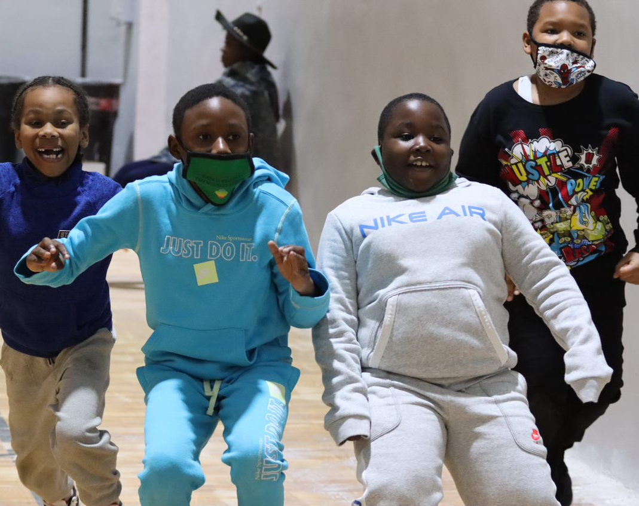
student survey results
student survey perception and participation data and gpras

Slide 25
student survey results
Student survey was administered in Feb 2023
Over 1000 5th – 12th grade students attending South Ward Promise Neighborhood partner schools completed a valid survey.
school attending
response rate
Enrollment data for North Star HS were not available
intro
academics
student survey
community survey
additional data
conclusions
Notes:
The student survey was developed by Child Trends, in cooperation with South Ward Promise Neighborhood. It was administered online to all enrolled 5th through 12th grade students attending participating partner schools. Partner schools coordinated the administration of the surveys, and had varying response rates, ranging from a high of 87% at Achieve Community Charter School, to a low of 1% at KIPP Collegiate High School. The overall response rate was approximately 28%. This is a low response rate, and results should not be considered representative or generalizable to students within the South Ward Promise Neighborhood.
For the purposes of GPRA reporting, only the responses of students in grades 6 through 12 are used.

Slide 26
student survey results
racial identity
 |  |  |  |  |  |  |  |  |  |  | 
 |  |  |  |  |  |  |  |  |  |  |  |  |  |  |  |  |  | 
 |  |  |  |  |  |  |  |  |  |  |  |  |  |  |  |  |  | 
 |  |  |  |  |  |  |  |  |  |  |  |  |  |  |  |  |  |  |  | 
 |  |  |  |  |  |  |  |  |  |  |  |  |  |  |  |  |  |  |  | 
 |  |  |  |  |  |  |  |  |  |  |  |  |  |  |  |  |  |  |  | 
 |  |  |  |  |  |  |  |  |  |  |  |  |  |  |  |  |  |  |  | 
black or african american
african national or caribbean islander
another racial identity
hispanic or latino
multiple races
missing
gender identity
girl
boy
non-binary, gender fluid, gender queer, or gender expansive
do not wish to answer
not listed or self-describe
intro
academics
student survey
community survey
additional data
conclusions
Notes:
The majority of student survey respondents identify as “Black or African American” and “Girl”.

Slide 27
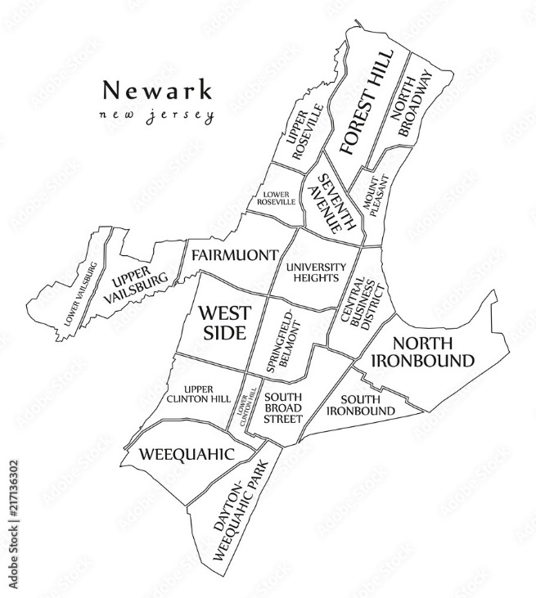
student survey results
residence
26%
42%
In SWPN
No Answer
32%
Outside SWPN
intro
academics
student survey
community survey
additional data
conclusions
n=1068
Notes:
The students who completed the survey live both in and around the South Ward Promise Neighborhood. Just over ¼ report living in the SWPN neighborhoods, while another 1/3 live outside the neighborhood, but in adjacent neighborhoods like the West Side, South Broad Street, and Springfield-Belmont. However, this is very limited data, as nearly half of the student respondents did not provide an answer to the question about where they lived.

Slide 28
student survey results
GPRA 6
children are healthy • percent of children who consume 5 or more servings of fruits and vegetables daily
This is an approximated percent based on responses to 4 questions about how many days in a week students consumed fruits and vegetables (see notes for more detail).
Eat 5+ fruits and veggies daily
22%
Promise Neighborhoods uses this to measure “children are healthy”, but the questions are very difficult to answer and responses are likely to be inaccurate. Consider with caution!
15%
2022 survey
intro
academics
student survey
community survey
additional data
conclusions
Notes:
GPRA 6 Children are Healthy (as measured by the number and percent who eat 5 or more servings of fruits and vegetables daily)
CURRENT DATA
Year 1 (2022-2023 survey) = 22% (209/960 6th – 12th grade students were identified as eating 5 or more servings of fruits and vegetables daily, based on responses to 4 questions on the student survey.)
PRIOR DATA:
Baseline (2021-22 survey) = 15% (70/463 6th – 12th grade students were identified as eating 5 or more servings of fruits and vegetables daily, based on responses to 4 questions on the student survey.)
DATA SOURCES and NOTES:
Only student responses from students in grades 6-12 are used to answer this measure for GPRA reporting purposes. Data collection and analyses for this GPRA follow instructions provided by the Promise Neighborhood technical assistance instructions. Students answer 4 questions:
During the past 7 days, how many times did you drink 100% fruit juices such as orange juice, apple juice, or grape juice? (Do not count punch, Kool-Aid, sports drinks, or other fruit-flavored drinks.)
Not counting fruit juice, during the past 7 days, how many times did you eat fruit?
During the past 7 days, how many times did you eat green salad?
During the past 7 days, how many times did you eat other vegetables (not including green salad), like carrots, broccoli, and potatoes? (Don’t count French fries, potato chips, and fried potatoes.)
For each question, students indicate they consumed the item not in the past week, 1 to 3 times in 7 days, 4 to 6 times in 7 days, 1 time per day, 2 times per day, 3 times per day, or 4 times per day. Each students responses to these questions are aggregated to determine the number of fruits and vegetables consumed in 7 days, and then averaged to determine the daily number. Students who have an average daily number of 5 or higher are considered to have consumed 5 or more servings of fruits and vegetables daily.

Slide 29
student survey results
GPRA 7a & b
children feel safe • percent of children who feel safe at school (a) OR traveling to & from school (b)
42%
45%
Feel safe at school
2023
2022
53%
57%
Feel safe traveling to/from school
intro
academics
student survey
community survey
additional data
conclusions
Notes:
GPRA 7a (students feel safe at school) and 7b (students feel safe traveling to & from school)
CURRENT DATA:
Year 1 (2022-23) = 42.3% (385/910
Year 1 (2022-23) = 52.6% (476/905)
PRIOR DATA:
Baseline (2021-22) = 45.2% (170/376)
Baseline (2021-22) = 56.6% (220/389)
DATA SOURCES and NOTES:
Only student responses from students in grades 6-12 are used to answer this measure for GPRA reporting purposes. Students are asked to indicate their agreement or disagreement with the statement “I feel safe at school” (GPRA 7a) and “I feel safe when I travel to school and home from school (on the bus, walking, etc.)” (GPRA 7b) using a 5 point scale with a “don’t know” option. Students who indicate “Strongly Agree” or “Agree” to are considered to feel safe.

Slide 30
student survey results
GPRA 7c
children feel safe • percent of children who feel safe at school and traveling to & from school
Feel safe at and traveling to/from school
This is a calculated by summing the number of students who either strongly agree or agree that they feel safe at school AND that they feel safe travel to/from school.
28%
Feel safe at and traveling to/from school
33%
intro
academics
student survey
community survey
additional data
conclusions
Notes:
GPRA 7c Children feed safe (as measured by the number and percent who feel safe at school AND while traveling to and from school)
CURRENT DATA
Year 1 (2022-2023 survey) = 27.7% (253/915 6th – 12th grade students indicated that they felt safe at school and traveling to and from school.)
PRIOR DATA:
Baseline (2021-22 survey) = 32.5% (109/335 6th – 12th grade students indicated that they felt safe at school and traveling to and from school.)
DATA SOURCES and NOTES:
Only student responses from students in grades 6-12 are used to answer this measure for GPRA reporting purposes. Students are asked to indicate their agreement or disagreement with the statement “I feel safe at school” (GPRA 7a) and “I feel safe when I travel to school and home from school (on the bus, walking, etc.)” (GPRA 7b) using a 5 point scale with a “don’t know” option. Students who indicate “Strongly Agree” or “Agree” to BOTH items are considered to feel safe for the purposes of GPRA 7c.

Slide 31
other safety perception results
student survey results
A large portion of students responded “Neutral” or “Don’t Know” to questions about safety.
intro
academics
student survey
community survey
additional data
conclusions

Slide 32
safety to/from school by mode of transportation
student survey results
Feel Safe
Neutral/Don’t Know
Unsafe
intro
academics
student survey
community survey
additional data
conclusions

Slide 33
student survey results
GPRA 10
children internet access • percent of children who school and home access to broadband internet and a connected computing device
The 2023 survey questions did not adequately capture access to broadband internet needed to measure this GPRA.
intro
academics
student survey
community survey
additional data
conclusions
Notes:
GPRA 10 Internet Access
CURRENT DATA (none is available and this was not reported due to a problem with the survey instrument used in the 2023 student survey).

Slide 34
ease of technology use
student survey results
This is a calculated by summing the number of students who responded that using technology for school assignments was very, somewhat, or slightly easy.
Easily use technology for school assignments
80%
intro
academics
student survey
community survey
additional data
conclusions
Notes:
Other data collected related to internet access included the ease with which students are able to access and use technology to complete school assignments. The large majority (80% or 852/1066) said that it is very easy (575), somewhat easy (195) or slightly easy (82) to use technology for school assignments. A minority (9%, or 92) indicated that it is very difficult (18), somewhat difficult (22), or slightly difficult (52) to use technology, while the remaining 11% (122) said it is neither easy nor difficult.

Slide 35
internet access at school by device
student survey results
intro
academics
student survey
community survey
additional data
conclusions
Notes:
Most students have access to the internet through their school computer lab/computer class (76%) or in academic classes (75%). A small minority (13%) have their own devices.

Slide 36
students have positive relationships even though they may not feel proud of or like they belong at their school
student survey results
intro
academics
student survey
community survey
additional data
conclusions

Slide 37
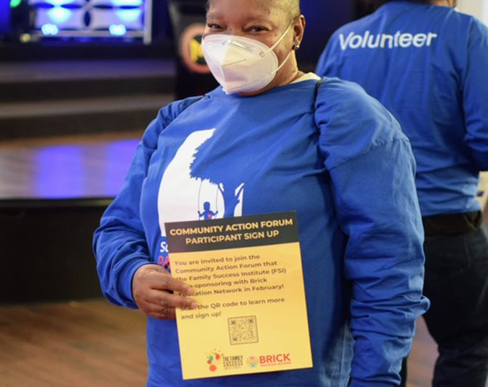
community survey results
parent/family member survey perceptions and gpras

Slide 38
community survey results
Community survey was administered in early 2023
Over 500 residents of the South Ward Promise Neighborhood completed a valid survey.
Phone Calls
Cornerstone Research conducted a phone survey, calling over 5000 phone numbers associated with people living in South Ward zip codes. They conducted 310 surveys.
Internet Reach
Child Trends administered the survey online through an open email invitation to residents of the South Ward. A total of 43 people responded and completed a survey.
Partner Invitation
South Ward Promise Neighborhood partner organizations distributed the survey link to their email lists. A total of 160 people completed a survey in response to receiving one of these emails. These respondents are referred to as “partner-connected” in this data presentation.
intro
academics
student survey
community survey
additional data
conclusions
Notes:
The phone calling and internet reach samples are considered random. The partner invitation sample is considered a convenience sample, as the respondents were connected to a SWPN partner in some way and reached not randomly, but through/because of this connection.
There are differences between the random sample and the partner-connected sample. These are noted at various points in these data.

Slide 39
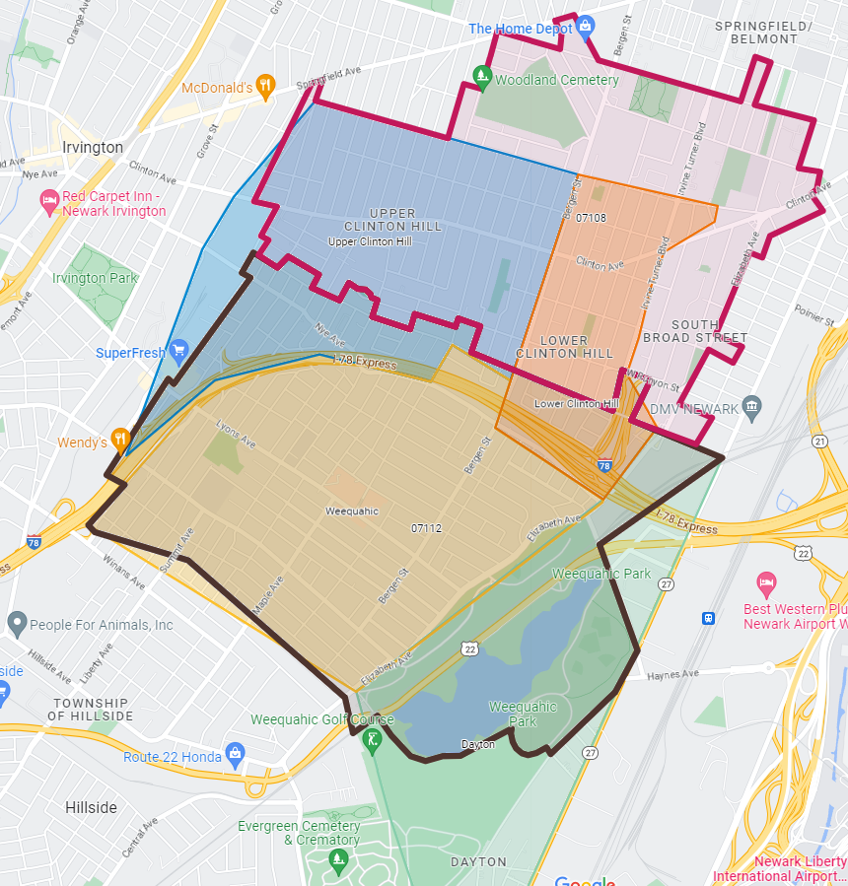
community survey results
Respondent residence
Respondents live in:
Clinton Hill 07108 = 229 or 45%
Weequahic 07112 = 241 or 47%
Dayton 07114 = 43 or 8%
229
241
43
intro
academics
student survey
community survey
additional data
conclusions
Notes:
Nearly all respondents (92%) live in the zip codes associated with the second (and current) round of Promise Neighborhoods funding. The others live in Dayton, which was a zip code associated with the first (prior) round of PN funding.
For the purposes of this data presentation, all responses are included, unless otherwise noted. Key exceptions include the GPRA data, which uses only respondents from 07108 and 07112.

Slide 40
community survey results
Over half of respondents are parents of children 18 & under
56%
Have child(ren)
all respondents
Partner-connected respondents were almost twice as likely to be parents of children 18 and under.
43%
79%
random sample
partner-connected sample
intro
academics
student survey
community survey
additional data
conclusions
Notes:
Parents of children 18 and under are a priority population for the PN funding.
“Parent” is the term used in this presentation, but respondents labeled “parents” in this presentation are those who indicated that they are a parent or caregiver of a child aged birth to 18 years old.
Additionally, there may be people who are parents to children over the age of 18 who are considered non-parents for the purposes of these data.

Slide 41
community survey results
over one-third of respondents have heard of SWPN
37%
Heard of SWPN
Heard of SWPN
55%
all respondents
partner-connected respondents
This increases to 55% among those who were invited to complete a survey by a SWPN partner. However, nearly half (45%) of people who are connected to SWPN organizations reported that they had not heard of SWPN.
intro
academics
student survey
community survey
additional data
conclusions

Slide 42
community survey results
GPRA 9.1
reading to children • percent of parents/families who read to their children (ages birth to 5-years old) or encourage their children to read (K-8th)
Encourage their K-8th grade children to read
Read to their young children
63%
80%
75%
Read to their young children or encourage their K-8th children to read to themselves or others
intro
academics
student survey
community survey
additional data
conclusions
Notes:
GPRA 9.1 parents/family members who read to their children ages birth to 5 or encourage their children in grades K-8 to read to themselves or others
CURRENT DATA:
Year 1 (2022-23) = 63% (52/82)
Year 1 (2022-23) = 80% (137/171)
Year 1 (2022-23) = 75% (189/253)
[PRIOR DATA are not available for these items].
DATA SOURCES and NOTES:
GPRA 9.1a: This analysis and reporting consists only parents of children ages birth-5 who live in zip codes 01708 and 07112 (n=86). Parents responded to the question “In a typical week, how often do you or any of your family members read to your child/children birth to 5 years old?” Answers of “every day” and “3-6 times a week” are considered valid for this GPRA reporting. Other answer options were “never”, “once or twice a week”, “don’t know” and “do not wish to answer”.
GRA 9.1b: This analysis and reporting consists only parents of children in grades K – 8 who live in zip codes 01708 and 07112 (n=171). Parents responded to the question “In a typical week, how often do you or any of your family members encourage your child/children in K-8th grade to read themselves, to a sibling, relative, or friend outside of school?” Answers of “every day” and “3-6 times a week” are considered valid for this GPRA reporting. Other answer options were “never”, “once or twice a week”, “don’t know” and “do not wish to answer”.
GPRA 9.1c is a calculated measure, summing the numerators from GPRA 9.1a and GPRA 9.1b, and dividing that by the sum of the denominators from both GPRAs.

Slide 43
community survey results
GPRA 9.2
college & career• percent of parents/families who talk about the importance of college with their children from 9th-12th grade
Talk about the importance of college
Talk about the importance of career
93%
88%
83%
Talk about BOTH the importance of college & career
intro
academics
student survey
community survey
additional data
conclusions
Notes:
GPRA 9.2 parents/family members who talk to their high school children about the importance of college (9.2a) or career (9.2b) and who talk about BOTH (9.2c)
CURRENT DATA:
Year 1 (2022-23) = 93% (76/82) who talk about the importance of college
Year 1 (2022-23) = 88% (71/81) who talk about the importance of career
Year 1 (2022-23) = 83% (69/83) who talk about BOTH
[PRIOR DATA are not available for these items].
DATA SOURCES and NOTES:
GPRA 9.2a: This analysis and reporting consists only parents of children in grades 9-12 who live in zip codes 01708 and 07112 (n=85). Parents responded to the question “In the first semester or term of this school year, how often have you or your child/children’s other parent or guardian provided information or advice about applying to college or other schools after high school?” Answers of “often” and “sometimes” are considered valid for this GPRA reporting. Other answer options were “never”, “don’t know” and “do not wish to answer”. A total of 82 parents provided responses to this item.
GPRA 9.2b: This analysis and reporting consists only parents of children in grades 9-12 who live in zip codes 01708 and 07112 (n=85). Parents responded to the question “In the first semester or term of this school year, how often have you or your child/children’s other parent or guardian provided information or advice about specific jobs your high school student might apply for after completing or leaving high school?” Answers of “often” and “sometimes” are considered valid for this GPRA reporting. Other answer options were “never”, “don’t know” and “do not wish to answer”. A total of 81 parents provided responses to this item.
GPRA 9.2c includes parents of high school students who answered “often” or “sometimes” to BOTH items.

Slide 44
community survey results
most parents talk to their teens about future plans
Often
Sometimes
Never
Planning and preparation for college entrance exams
Applying to college or other schools after high school
Specific jobs your child might apply for after completing/ leaving high school
Selecting courses or programs at school
intro
academics
student survey
community survey
additional data
conclusions
Notes:
Parents of high schoolers were asked how often they talk to their children about various aspects of their college and careers. Only a small minority of parents said that they never talk about these things with their teens. However, high schoolers were far less likely to report having these conversations with their parents.

Slide 45
student survey results
but teens may not recall these conversations
as indicated by their recollection of how often their parents talk to them about these topics
Often
Sometimes
Never
Planning and preparation for college entrance exams
Applying to college or other schools after high school
Specific jobs your child might apply for after completing/ leaving high school
Selecting courses or programs at school
intro
academics
student survey
community survey
additional data
conclusions
Notes:
These data come from the student survey, where high school students were asked how often their parents talked to them about the same topics that parents were asked about. They were far more likely to report that these conversations never happen, or that they only happen sometimes.

Slide 46
community survey results
two-thirds of respondents are working
Full-Time
Partner-connected respondents were 3x more likely to work part-time jobs.
Part-Time
More than 1 job
Not Working
intro
academics
student survey
community survey
additional data
conclusions
Notes:
Two-thirds of all respondents said that they currently have a job (n=508)
There was a difference by survey respondent type. Those who were randomly contacted through the phone or internet were more likely to be employed full-time than those who responded to partner requests (partner-connected). They were also more likely to feel that their current job met their financial needs, which might be related to the fact that they were more likely to have a FT job.
The question asked respondents to indicate whether they worked part-time, full-time, more than one job, or not at all. So we do not have any additional info on the “more than one job” group, such as whether those are a PT and a FT, 2 FT, 2 PT, etc.

Slide 47
community survey results
the financial needs of some are met, but parents struggle
58%
Financial needs are met
Meets financial needs
Doesn’t meet
Random
Not Parents
Partner-connected
Not Parents
Random
PARENTS
Partner-connected
PARENTS
intro
academics
student survey
community survey
additional data
conclusions
Notes:
Among those who are working, 58% report that their financial needs are met by their current job (n=324)
There was a difference by survey respondent type. Those who were randomly contacted through the phone were more likely to be employed full-time than partner-connected respondents. They were also more likely to feel that their current job met their financial needs, which might be related to the fact that they were more likely to have a FT job.
Parents, whether randomly contacted or reached through partner contact, were less likely to report that their financial needs are met by their current job.

Slide 48
community survey results
most people seek health care at a doctor’s office
92%
97%
Have a place they usually go when sick
adults
children
Doctor’s Office
Hospital ER
Clinic or Urgent Care
intro
academics
student survey
community survey
additional data
conclusions
Notes:
Almost everyone has a place that they go when they are sick or take their child when the child is sick.
Over half of people selected just one location that they usually go when they are sick.
Most people who have just one place they go said they go to a doctor’s office, but around ¼ usually go to either an ER or a clinic or urgent care facility.

Slide 49
community survey results
most parents are the main childcare for their kids
Self or Partner
Other in-home
younger children are more likely to be cared for outside the home.
PreK or Head Start
Daycare
Self or partner
n=56
Other in-home
Self or Partner
Other in-home
School Care
Other
intro
academics
student survey
community survey
additional data
conclusions
Notes:
Parents with children in 8th grade or younger were asked about their current childcare arrangements. The majority indicated that they or their partner/spouse is their main childcare provider, followed closely by a relative or friend. A non-majority use out-of-home care, such as a pre-K or child care in a school, before or after school care, daycare, or Head Start.
Younger children are more likely to be cared for outside the home.

Slide 50
thank you
contact information
For more info, please contact us at
Caroline Taggart
Via Evaluation
caroline@viaeval.com
716.362.0627

